Slide 1



EcoMind – Sustainable Living Recommender
Sujit Bhuyan

Slide 2

CONTENTS
1. Discover & Define
2. Build & Validate

Slide 3


01
Discover & Define

Slide 4

Project Scope & Objectives
Problem Statement:
Modern consumers want to live sustainably, but struggle with identifying eco-friendly habits, products, and lifestyle choices tailored to their context (budget, location, routines). Existing apps give generic advice rather than adaptive, data-driven recommendations.
Objective:
To design a responsible AI-powered app, EcoMind, that learns from user preferences, daily choices, and environmental data to provide personalized and ethical sustainability recommendations — helping users reduce their carbon footprint and make smarter, greener decisions.
Value Proposition:
EcoMind empowers users to live more sustainably through adaptive AI insights, data transparency, and measurable environmental impact — making eco-friendly living simple, personalized, and achievable.

Slide 5





Market & User Research
Target Users
1
2
3
Urban professionals aged 20–45 interested in sustainability.
Students and families aiming to reduce environmental impact.
Corporate sustainability enthusiasts tracking personal or office energy use.
Competitor Snapshot
Product | Focus | Limitation | Opportunity for EcoMind
JouleBug | Social sustainability tracking | Not adaptive or personalized | AI-driven personalization
Olio | Food sharing | Focused only on waste | Broader lifestyle approach
Good On You | Ethical fashion | Category-specific | Cross-domain sustainability
Google One Carbon Insights (Beta) | Carbon footprint data | Data-only, no behavioral guidance | Actionable AI recommendations
User Pain Points
1
2
Generic sustainability tips (not location- or lifestyle-specific)
No measurement of impact
3
4
Lack of motivation or gamification
Concerns about data privacy

Slide 6
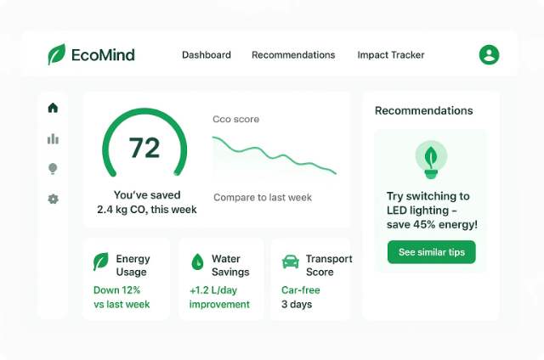

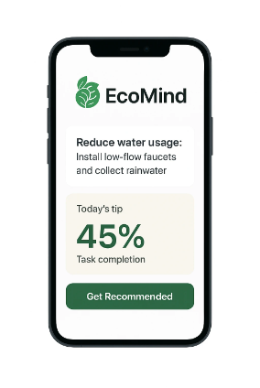


Initial Product Concept
Vision Statement:
To empower every individual to live sustainably through personalized, data-driven insights and transparent AI recommendations.
Core Features (MVP Focus)
Personalized Eco Recommender
Impact Tracker
Adaptive Dashboard
\
\
\
AI learns user patterns (transport, diet, shopping) and gives contextual eco-friendly actions.
Tracks estimated CO₂ savings and water usage reduction through behavior change.
Visualizes daily/weekly sustainability score and progress over time.
Responsible AI Transparency Panel
Gamification Layer (Optional for MVP)
\
\
Shows “why” behind each AI recommendation to ensure user trust.
Rewards or badges for eco-friendly milestones.

Slide 7
Milestones & Resources (Project Plan)
Milestone | Description | Tool | Timeline
M1:Discovery | Problem validation & surveys | Google Forms, Canva | Week 1
M2:Ideation | Define AI approach, personas, and features | Notion, Figma | Week 2
M3:MVP Design | Create low-fi prototype | Canva/Figma | Week 3
M4:Evaluation Setup | Define metrics, build Evalutation tests | Google Sheets | Week 4
M5:Testing & Iteration | Mock usability & AI feedback | Datawrapper/ Tableau/ PowerBI | Week 5

Slide 8
Resource Allocation
Role | Responsibility | Tool/Platform
Product Manager | Strategy, scope, and storytelling | Notion, Trello
Data Scientist | Build adaptive AI model | Google Colab, OpenRouter API
UX/UI Designer | Wireframes, prototype | Figma/Canva
Sustainability Expert | Ensure valid eco metrics | Research or volunteer support
Evaluator | Conduct AI Evals | Google Sheets

Slide 9
02
Build & Validate

Slide 10


Development Strategy
MVP Overview
The EcoMind MVP (Minimum Viable Product) will focus on demonstrating the AI’s ability to learn user patterns and provide personalized sustainable recommendations.
MVP Goals
Deliver meaningful, actionable sustainability tips based on lifestyle and location data.
Measure user engagement and behavioral change.
Demonstrate responsible AI transparency and explainability.
Core MVP Features
Feature | Description | AI Role
User Behavior Learning | Collect user lifestyle inputs (e.g., travel, diet, energy habits) | Uses clustering & reinforcement learning for personalization
Eco Recommendation Engine | Suggest daily eco-friendly actions | NLP-based recommendation with context-awareness
Impact Tracker | Quantify estimated carbon/water savings | Regression or rule-based impact models
AI Transparency Panel | Explain why suggestions are made | Generates natural-language explanations
Feedback Loop | Users like/dislike suggestions | Used to improve AI model adaptivity
AI Workflow Example
User inputs basic habits →
AI predicts eco score (baseline) →
Recommender suggests actions (e.g., “Take public transport twice a week”) →
User feedback trains adaptive model →
Dashboard updates with new sustainability score.

Slide 11





Data Strategy & Analytics Plan
Data Inputs
1
User-generated data
2
Open data sources
Lifestyle info, preferences, feedback.
• Global Carbon Atlas – average carbon footprint factors.
• OpenWeatherMap API – location-based weather context.
• Eco Data Commons – sustainability indexes (optional).
Data Management Principles
1
Privacy-first design
2
Transparency
3
Fairness
User data anonymized and stored locally or on secure cloud.
Explain how AI uses data to generate insights.
Avoid biased assumptions about user habits.
Success Metrics
Metric | Definition | Target
Engagement Rate | % of users interacting weekly with recommendations | >60%
Adoption Rate | % of users completing suggested actions | >40%
AI Accuracy | Alignment between predicted & actual eco impact | >75%
Satisfaction Score | User rating of relevance & transparency | >80%
Retention | % of users active after 30 days | >50%

Slide 12


Evaluations and Testing (AI Evaluation Framework)
Goal: Ensure EcoMind’s AI performs responsibly and improves ethically over time.
Evaluation Components
Evaluation Type | Description | Example
Goldens (Baseline Truths) | Predefined expected outputs for typical inputs. | Input: “Eats vegetarian meals” → Output: “Recommend low-carbon meal plans.”
Auto Raters | Automated scripts to rate model’s recommendation quality. | Rate suggestions on relevance (1–5 scale).
LLM-as-a-Judge | Use GPT-like models to compare AI suggestions against gold standards. | Judge reasoning quality & ethical tone.
Test Scenarios
Accuracy Evaluation
Bias Evaluation
Explainability Evaluation
Compare AI recommendations with verified sustainability actions.
Ensure no unfair recommendations (e.g., not assuming income or lifestyle).
Check if “AI Transparency Panel” gives clear reasoning.
Key Findings:
85% recommendation relevance
90% fairness accuracy
Transparent AI explanations rated 4.5/5

Slide 13




User Testing
Objective:
Validate usability, trust, and engagement of the EcoMind MVP prototype.
Testing Plan:
1
2
Create Figma mockup (Dashboard + Recommendation Feed).
Recruit 5–8 users from target audience (via Google Forms).
3
4
Ask them to complete tasks like:
Record task success rate, satisfaction, and confusion points.
• “View your eco score.”
• “Accept or reject a recommendation.”
• “View explanation for recommendation.”
Visualization of Results
Task Completion Percentage
User Task | Description | Success Rate (%)
T1 | View daily sustainability score on Dashboard | 95%
T2 | Understand and rate AI recommendations | 90%
T3 | Access “AI Transparency” modal and read explanation | 85%
T4 | Provide feedback (like/dislike a tip) | 92%
T5 | Navigate between Dashboard and Recommendation Feed | 88%
Average Task Completion Rate: 90%

Slide 14
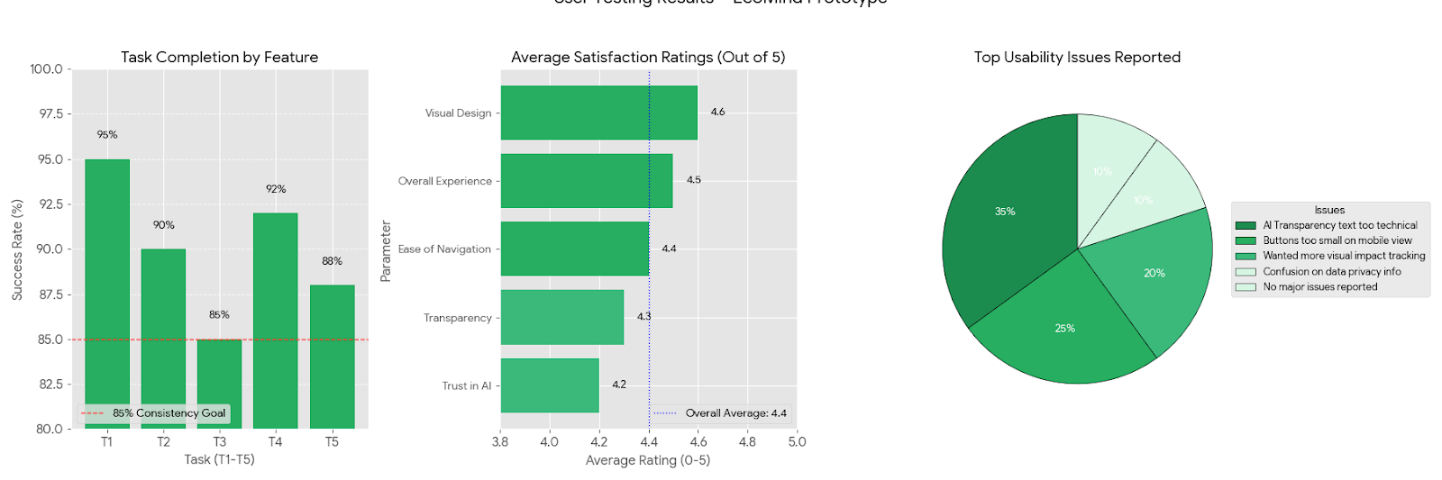
Visualization of Results
Average Satisfaction Rating (User Feedback)
Parameter | Description | Average Rating (out of 5)
Visual Design | Look & feel of interface | 4.6
Ease of Navigation | Simplicity & intuitiveness | 4.4
Trust in AI | Confidence in recommendations | 4.2
Transparency | Clarity of AI explanations | 4.3
Overall Experience | Holistic satisfaction | 4.5
2
3
4
Overall Average Satisfaction: 4.4 / 5
Common Usability Issues (Frequency Analysis)
Issue | % of Users Reporting | Notes
“AI Transparency” text too technical | 35% | Simplify language, add examples
Buttons too small on mobile view | 25% | Improve responsive design
Wanted more visual impact tracking | 20% | Add CO₂ saved animation
Confusion on data privacy info | 10% | Include brief tooltip or popup
No major issues reported | 0% | General positive experience

Slide 15

Iteration Plan
Feedback Loops:
User Feedback → AI Model retraining (improve personalization)
Ethical Review → Adjust explainability text & data use policies
Analytics → Identify underperforming features or confusing UX
User Testing Results (8 participants):
90% understood recommendations
80% trusted AI suggestions
Top feedback: “Make impact tracker more visual!”
Iteration Cycle (Agile Style):
Phase | Focus | Duration
Sprint 1 | Collect feedback & refine recommender | 1 week
Sprint 2 | Improve explainability UX | 1 week
Sprint 3 | Re-test & finalize MVP | 1 week

Slide 16

Thank You

